Slide 1

Serving a Changing Mission Field
Laity Session
Rev. April Casperson
Methodist Theological School in Ohio
West Ohio Conference

Slide 2
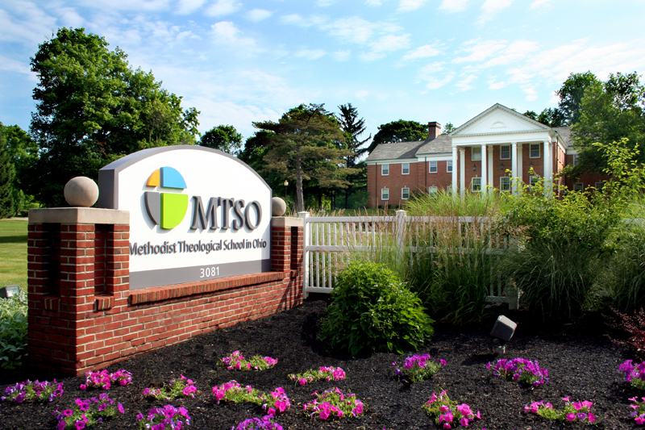
Rev. April Casperson
Director of Enrollment Management, Methodist Theological School in Ohio
Diversity, Equity, Inclusion Consultant
Deacon, West Ohio Conference
Previously Director of Diversity and Inclusion, West Ohio Conference

Slide 3
Romans 12:3-5 (NRSV)
For by the grace given to me I say to everyone among you not to think of yourself more highly than you ought to think but to think with sober judgment, each according to the measure of faith that God has assigned.
For as in one body we have many members and not all the members have the same function, so we, who are many, are one body in Christ, and individually we are members one of another.

Slide 4
Romans 12:3-5 (First Nations Translation)
Because Creator, in great kindness, has made me a message bearer, I give this message to each of you:
Do not think too highly of yourself. Instead, understand that the Great Spirit calls us to different purposes in answer to our trust in Creator. For just as our bodies have many members and each member has a different purpose, it is the same way with the body of the Chosen One. We are members of Creator’s body, and each member belongs to all the others.

Slide 5
Cultural competence is loosely defined as:
The ability to understand, appreciate and interact with people from cultures or belief systems different from one's own. (APA, 2023)

Slide 6
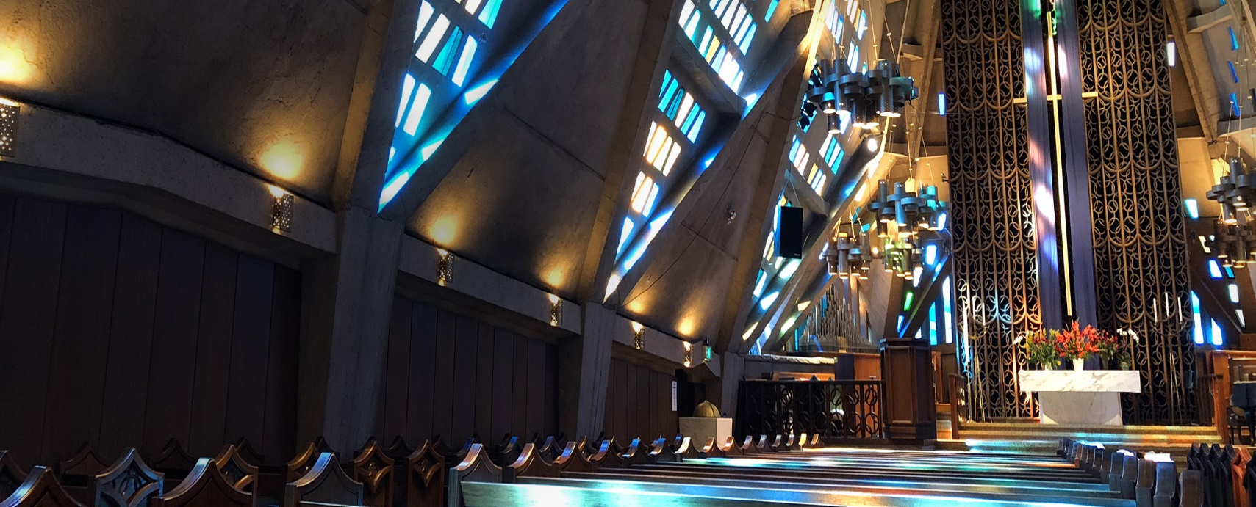
We lead because of the people we serve.

Slide 7
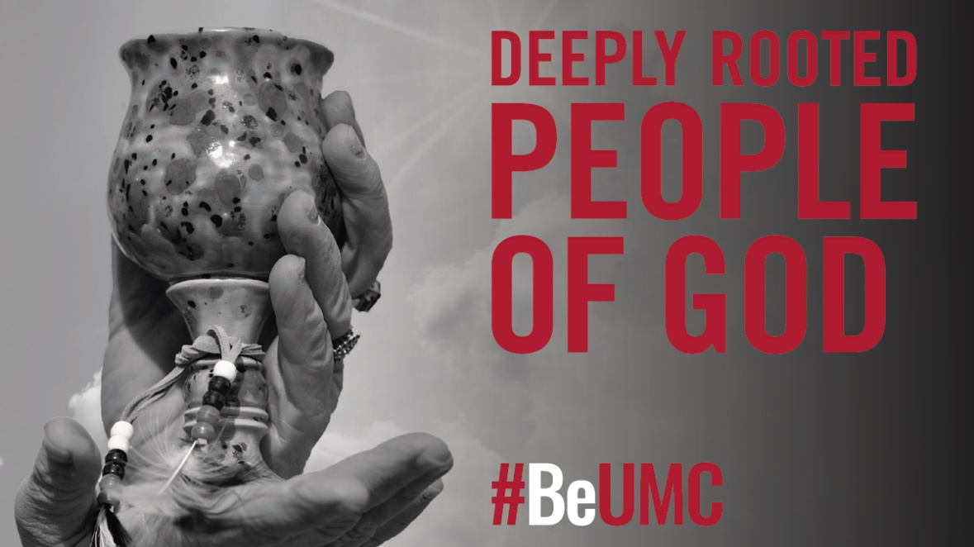

Slide 8
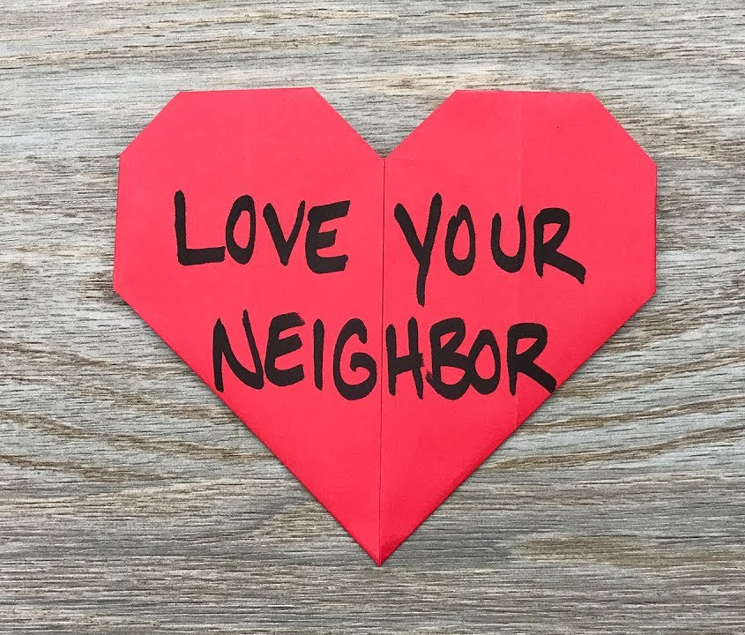
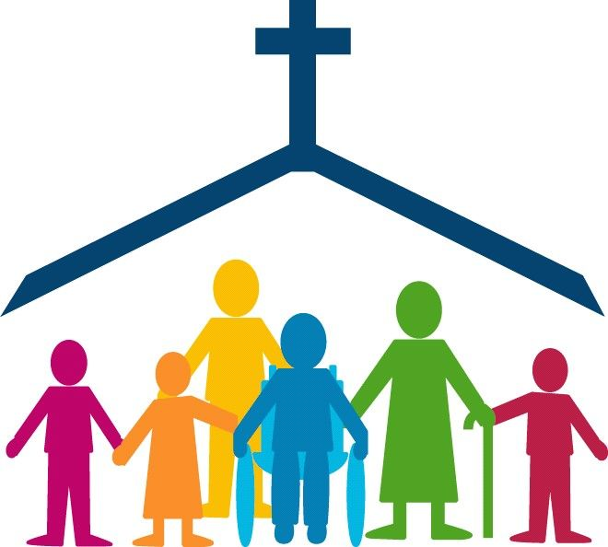
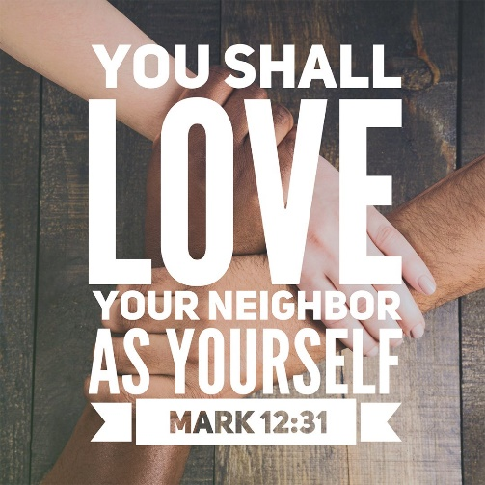
Opening ourselves up to caring about people who are different from us is a risky thing.
Notes:
Lots of churches say that they love everyone? But they may not – deliberately or otherwise.

Slide 9
Our faith is our “why.”
We are reminded that our faith is based upon reaching out to those who are different from us.
Our faith empowers us to reach across difference.

Slide 10
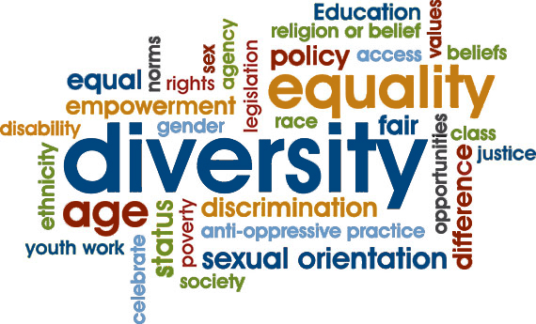

Slide 11

Justice
Equity
Diversity
Inclusion
=
JEDI

Slide 12

As we explore these definitions, think about how they may apply to:
Lay leadership in your local church
Your ministry within the district and annual conference
Your annual conference as a whole

Slide 13
Diversity is simply any difference that makes a difference.
Individual + individual = diversity
Individual + group = diversity
Group + group = diversity
Church + church = diversity

Slide 14
We all have multiple dimensions of diversity.
Age/Generation
Race/Ethnicity
Gender/Sexuality
Socioeconomic Status
Ability/Disability
Immigration/Citizenship
Geography (where you live)
Sheltering (how you live)
Religion
Political Views
Educational Background
Neurodiversity
Language(s)
Addiction
Incarceration

Slide 15
Small Group Discussion
What are the dimensions of diversity showing up in your local church?
What are the dimensions of diversity showing up in your annual conference?

Slide 16
Equity
Equality means providing the same to all.
Equity means recognizing that we do not all start from the same place.
We must acknowledge and make adjustments to imbalances.
The process is ongoing, helping us identify and overcome intentional and unintentional barriers arising from bias or systemic structures.

Slide 17
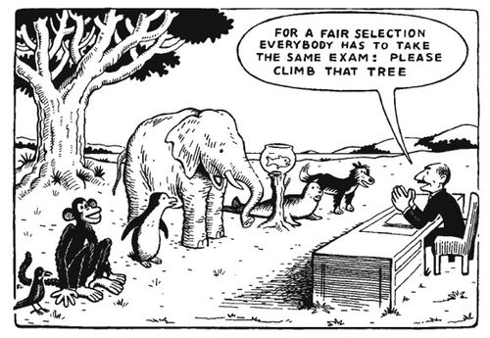

Slide 18
Conversations About Equity
When we talk about diversity, equity, and inclusion in churches,
some people think that this means that we are lowering our standards
or letting go of our beliefs.
That is not true.
Practicing equity in our local churches and annual conferences
maximizes our ministry impact and
creates space for new ministry partners.

Slide 19
Justice
Justice means fair treatment of all people, which looks like:
Respect for the rights of people who have been marginalized
Equitable distribution of resources
Fairness manifested in society and organizations
Personal responsibility to collaborate with others to design and continually perfect institutions as tools for personal and social development

Slide 20
Inclusion
An organizational effort and practices in which different groups or individuals having different backgrounds are culturally and socially accepted, welcomed, and equally treated.
Inclusion creates a sense of belonging.
Inclusion helps people feel respected and valued for who they are as an individual or group
Inclusion often means a shift in a church’s mind-set and culture that has visible effects.

Slide 21


Slide 22

Healthy belonging and healthy leading embraces difference.

Slide 23
How can we better work across difference?
It can be tempting to “just ignore” diversity and difference. But the UMC’s adaptive challenges for the coming years include:
Recruiting and retaining diverse clergy leaders
Helping our churches embrace changing demographics
Living into a “right-sized” annual conference
Leading across theological and political lines
Moving from “equality” to “equity” in local church and annual conference decision making

Slide 24
Small Group Discussion
What would be a way for your church to work across difference?
What is an opportunity you see for your church’s ministry in the coming months?

Slide 25
The best way to engage in these priorities is to learn how to better reach across difference.

Slide 26

Let’s look at some hypothetical churches…

Slide 27
A Polarized Church
Tolerant of a limited number of “token” people from other groups
Prioritizes holding onto power and privilege through practices, teachings and decision making
Often declares: “We don’t have a problem.”
Comfortable with the status quo
Avoids discord and conflict
Norms, policies and procedures are always the end of the conversation
Engages social justice outreach on the leaders’ terms

Slide 28
A Cautious, Maintaining Church
Making assumptions about clergy, laity, other churches, ministry partners
Relationships without transparency, authenticity, or vulnerability
Frustration with initiating change
Avoids discord and conflict
Disinterest in engaging new people
For people of diverse backgrounds, pressure to “go along to get along.”
Traditionally marginalized groups not feeling valued
“Performative justice seeker”

Slide 29
A Welcoming, Growing Church
De-escalated conflict within the church
Increased growth mindset
Willingness to engage in systemic change
More innovation = trying new things
New people engaged in organizational mission and vision
People of diverse backgrounds feeling valued
Meeting and seeing people where they are

Slide 30
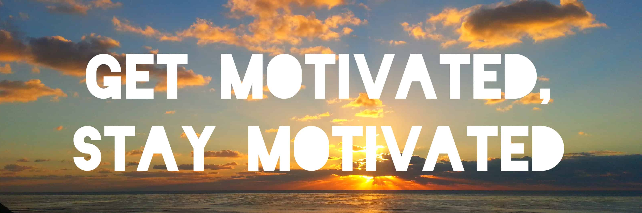

Slide 31

Change takes time.

Slide 32
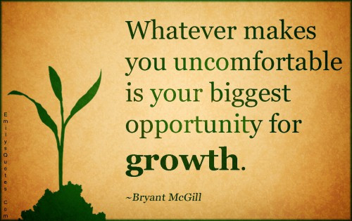

Slide 33

What does this mean for your local church?
A local church becomes more accepting, adaptive, and anti-racist as members develop the capability to connect across difference.

Slide 34

Your Path Forward: The “What”
The next few slides lay out a strategic pathway for transformation within a local church.
Please keep in mind that your church might have already implemented several portions of this pathway.

Slide 35

Symbolic Change,
Then Identity Change

Slide 36
Symbolic Change is the first step. It will feel like it is “not enough.” That is true – because it is the first step.
Symbolic Change looks like:
Preaching about welcoming all people
Making public statements about your church’s values
Showing up in places that lift up your church’s welcoming values

Slide 37
Then…Identity Change.
Identity Change = your action steps.
Equip your church to connect with new people in new ways
Creating anti-racism training that fits your church
Explore where you might have institutionalized white power and privilege
Assess budgets and programming for outcomes
Actively connect with members of groups that have been historically denied access and opportunity

Slide 38
Growth Takes Time.

Slide 39


Slide 40
We don’t need just technical solutions.
We need cultural shifts.
That is our “how.”

Slide 41

Our faith is not simply an intellectual asset but an active, trusting relationship with God through Christ that, in the power of the Holy Spirit, leads to transformative experiences of God’s glory.
What’s next? Listening for the movement of the Holy Spirit, guiding your church into a culture shift.

Slide 42
For now:
Start thinking about the dimensions of diversity that
have shaped you.
What do you bring to your lay leadership and local church
as a result of your own unique identity?

Slide 43
Small Group Discussion
Share about dimensions of diversity that
have shaped you.
What do you bring to your lay leadership and local church
as a result of your own unique identity?

Slide 44

Rev. April Casperson | acasperson@mtso.edu

